Slide 1
Bank Analysis

Slide 2
Group - 3
Vivek Kumar
Minal Hemant Sangle
Ryali Sai Swetha
Prasad Nivas Dongre
Lalit Manik Chaudhari
Akshay Sunil Sangave
Siya Rehmatulla Agwan

Slide 3
Introduction
We are pleased to introduce our Bank Analysis Dashboard, a project designed to enhance the understanding and management of key banking metrics. Developed using Power BI, Excel, Tableau, and SQL, this dashboard offers a clear and detailed view of various critical performance indicators.
It includes an analysis of loan amounts by year, revenue balance by grid and subgrid, loan status by state, non-performing statuses by month, and a comparison of home ownership with the last payment details. This tool has been crafted to provide stakeholders with a straightforward yet comprehensive overview of banking operations, facilitating informed decision-making and strategic insights.

Slide 4
KPI
Year wise loan amount Stats
Grade and sub grade wise revol_bal
Total Payment for Verified Status Vs Total Payment for Non Verified Status
State wise and month wise loan status
Home ownership Vs last payment date stats

Slide 5
Tools used
EXCEL
POWER BI
TABLEAU
SQL

Slide 6
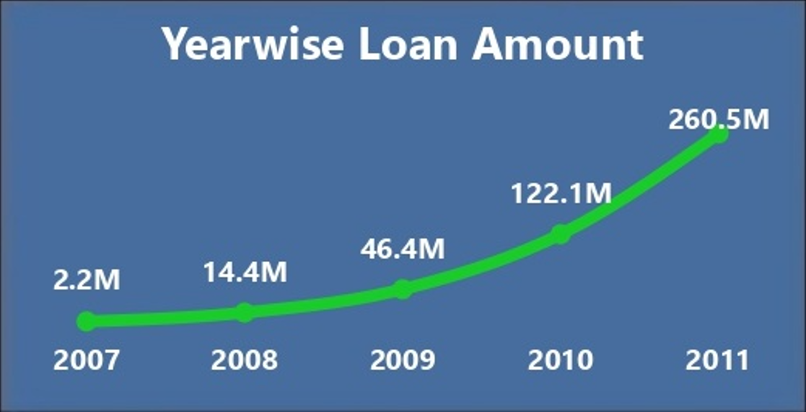
1.Year wise loan amount Stats
Observation: There has been a significant 11740% growth in the loan amount taken from 2007 to 2011, with a massive jump observed between 2009 and 2011.
Suggestion: Explore the factors driving this surge in loan amount during the specified period to identify potential market trends or economic conditions that influenced borrowing behavior. Consider adjusting lending strategies or product offerings based on these insights to better meet customer needs.

Slide 7
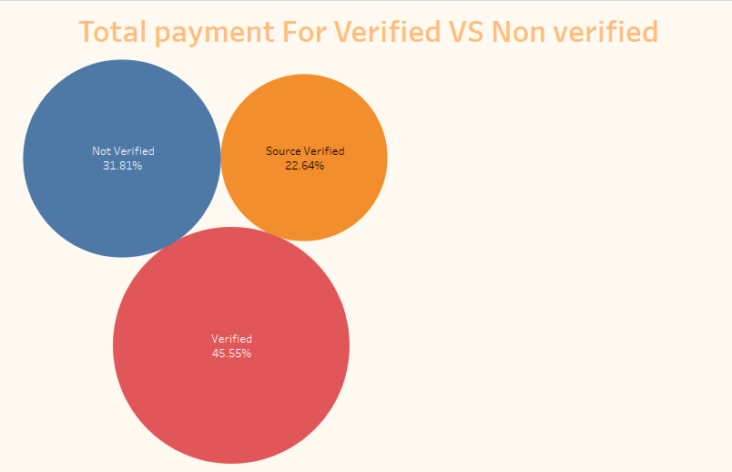
2.Total Payment for Verified Status Vs Total Payment for Non Verified Status
Observation: Loans with a verified status have the highest sum of total payments, followed by not verified and source verified statuses.
Suggestion: Investigate the reasons behind the higher total payments associated with verified status loans. Evaluate the verification process and its impact on borrower reliability and repayment behavior. Consider refining the verification criteria or processes to enhance loan performance and mitigate risk for all status categories.

Slide 8
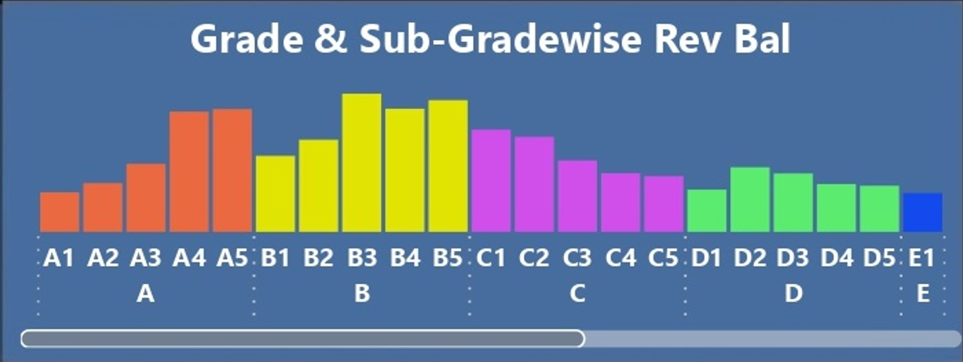
3.Grade and sub grade wise revol_bal
Observation: Sub-grade B3 within grade B accounts for a notable 7.47% of the total sum of revolving balance (revol_bal).
Suggestion: Conduct further analysis to understand the characteristics of borrowers falling under sub-grade B3 to identify any specific risk factors or patterns influencing their revolving balance. This understanding can inform credit risk assessment and help tailor lending strategies for borrowers in this sub-grade.

Slide 9
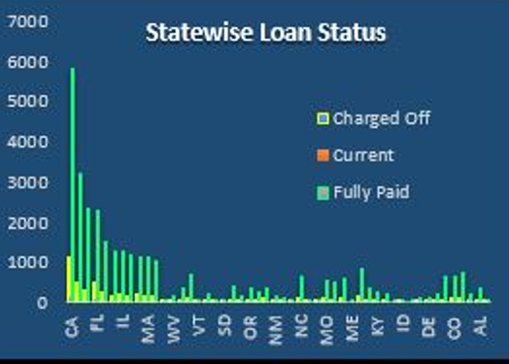
4.State wise and month wise loan status
Observation: Across 31 states, the total loan amount disbursed sums up to $403,695,875, with an average loan amount of $13,022,447.58.
Suggestion: Analyze the distribution of loan amounts across different states and months to identify regions or time periods exhibiting higher or lower loan demand. Utilize this information to optimize resource allocation and marketing efforts in regions with higher demand or to address potential gaps in lending opportunities in other regions.

Slide 10
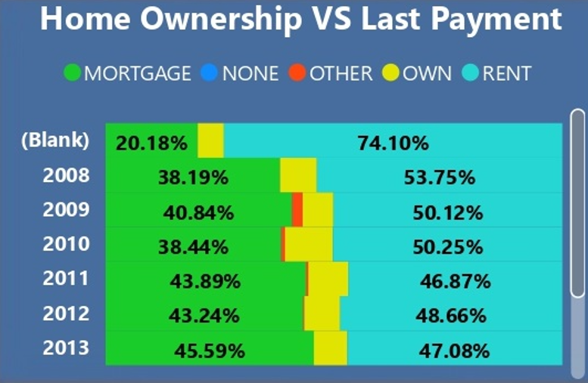
5.Home ownership Vs last payment date stats
Observation: The sum of IDs for 'OTHER' category homeownership started trending upwards in 2009, showing a significant rise of 230.13% over three years.
Suggestion: Investigate the factors contributing to the increasing trend in 'OTHER' category homeownership starting from 2009. Evaluate market conditions, demographic shifts, or changes in homeownership preferences driving this trend. Consider tailoring marketing strategies or product offerings to cater to the evolving needs of 'OTHER' category homeowners to capitalize on this growing market segment.

Slide 11
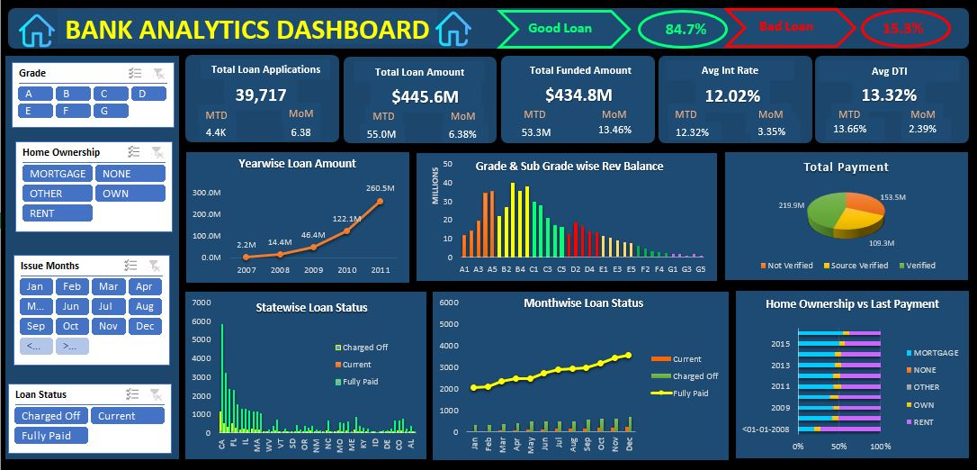
Excel dashboard

Slide 12
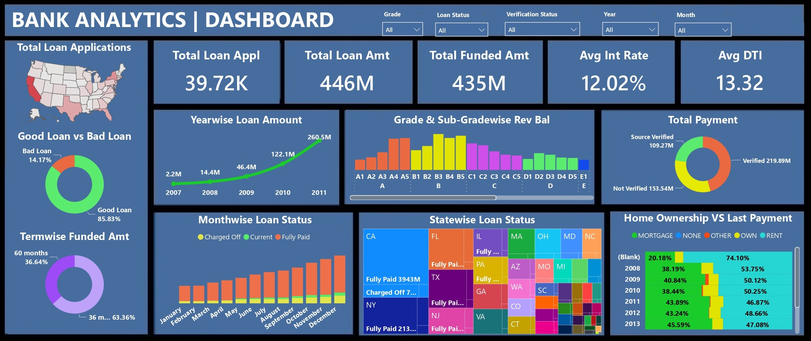
powerbi dashboard

Slide 13
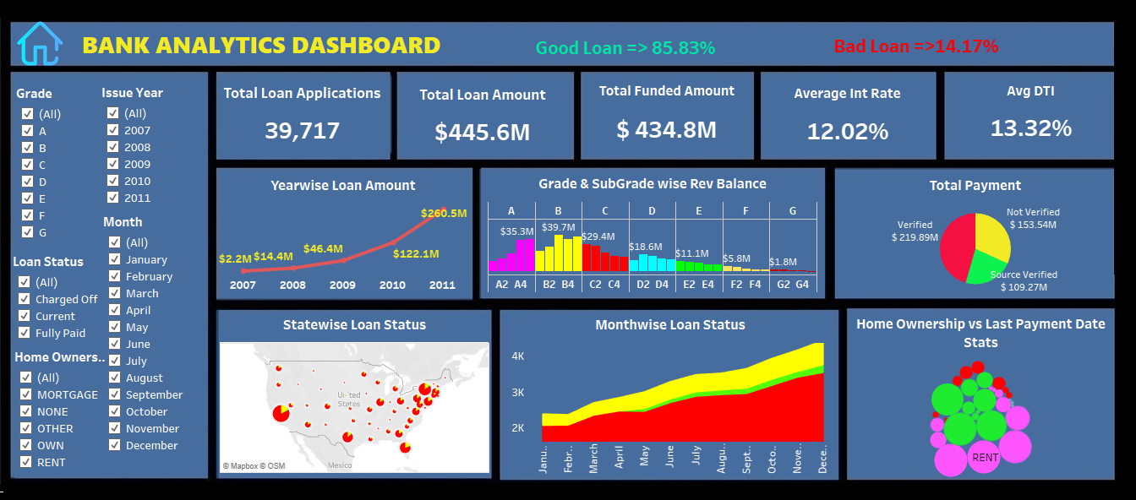
Tableau dashboard

Slide 14

Thank you

